Slide 1
Application of Liquid Rank Reputation System for Content Recommendation
Abhishek Saxena Scientific Advisor: Prof Anton Kolonin
NSU, 2022
*Accepted for publication in USBEREIT-2022 IEEE Conference, Yekaterinberg

Slide 2

Challenges and Value Added by Thesis Work
Collaborative Filtering, Content-Based Filtering, Hybrid Models:
There are Bot Armies which can easily sway the results on Twitter, Telegrams, Youtube, etc.
“Nearly two-thirds of the social media bots with political activity on Twitter before the 2016 U.S. presidential election supported Donald Trump”: Source- https://arxiv.org/abs/1810.12398
Recommendations of the most populat platforms like Twitter, Youtube, etc are easily manipulated by scam channels, reviews and ratings.
Personalisation on recommendations get overwhelmed with our own following (likes, subscribed, searches).
Overall the large/most popular content gets recommended (Mathew’s Effect).
Who will rate the raters?
Need of the hour is to have a recommendation model just based on unbiased network ratings, following Thesis work leads one step towards that, Liquid Democracy. (Commercial Usage available)

Slide 3
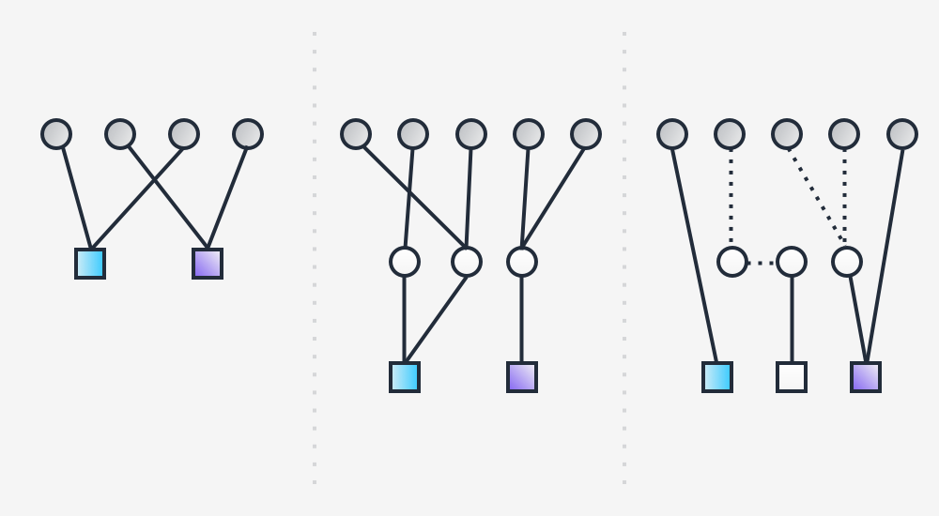
What is Liquid Ranking System?
Direct Democracy Representative Democracy Liquid Democracy

Slide 4
What is Liquid Ranking System?
Liquid Democracy is implemented through Liquid Ranking.
Liquid Ranking is nothing but earned rank in a Liquid Democracy (eg. Decentralised Platforms)
Most of representative democracies have failed because they were overshadowed by financial powers.
So, the answers come through the reputation power of individuals for the ranking.
Each rank is calculated by the individuals on a platform, through features eg. followers, likes, comments, subscribers, etc.

Slide 5
Liquid Ranking Reputation System
Computational model of Reputation rating is calculated as
Here
V: Mentions F: Followers
O: Likes (favourites) D: Retweets (sharing)
C: Comments (sentiments) S: Personal Recommendation
R_{i}: Current reputation of i_{th} node (initially considered as 1 for all, “Liquid Weight”)
V_{ijt}: It can be implicit rating as positive or negative vote or implicit rating as wire transfer amount (“Rating Weight”), either spent or received, for node j being rated, node i supplying the rating and time t.
$$Rj =\sum{(Ri ∗ Vijt)} +\sum{(Ri ∗ Fij)}+\sum{(Ri ∗ (Oijt+Cijt+Dijt+Sijt)}∗$$

Slide 6
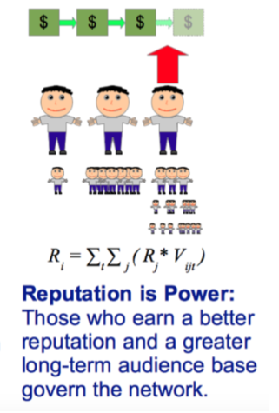
Liquid Ranking Reputation System
In all reputation system provides the distribution of liquid weights while ranking every iteration before normalisation.
Each part of the algorithm can also have variable weight distribution.
The algorithm covers not only direct and time independant variable like Followers, but also time dependant variables i.e likes, comments, mentions.
The thesis opens up a new feature in recommendation using the reputation score, where the reputation of the channel/person can increase/decrease as per his/her acceptance by other fellow members on the platform.
In the thesis mentions are selected to be the prime feature to consider the reputation score for liquid ranking.
$∗$ Kolonin A. et al, Aigents Group & SingularityNet Foundation, 2017

Slide 7
Liquid Democracy in recommendation: State of the Art
It can be implemented through Liquid Ranking.
Liquid Ranking algorithm is developed to work as a hybrid feature for content recommendation (a dynamic recommendation model).
Each rank can be calculated by the individuals on a platform, through features eg. followers, likes, comments, subscribers, etc (we have used Mentions in Twitter Data)
Liquid Ranking algorithm is tested to get the opinion leaders or most influencial channels in the given time frame for crypto news versus just based on the mentions of channels.
Dataset scrapped from Twitter contained 37605 tweets by 10000+ channels/accounts on Twitter.
Cold Start or “higher level friends” in our case were passed by selecting initial 30 channels which are pro-active cryptocurrency related accounts.
The top 50 channels recommended (on both scales) were rated on 0-2 scale (for qualitative analysis). Crypto data. 0 is given to channels which have least influence and 2 to most influent. Hence “Relavant” Channels are those which have score of 2, and the rest are considered as “Irrevelant”.

Slide 8
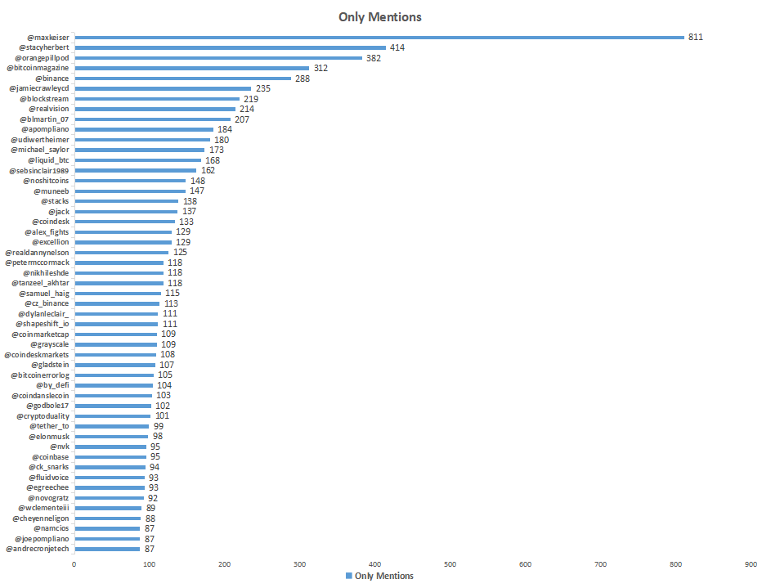
Results: Ranking Based by Mentions

Slide 9
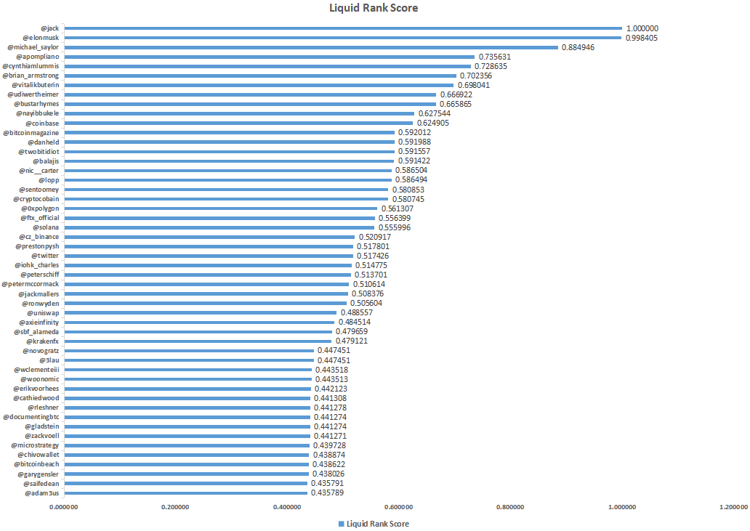
Results: Ranking Based by Liquid Rank Score

Slide 10
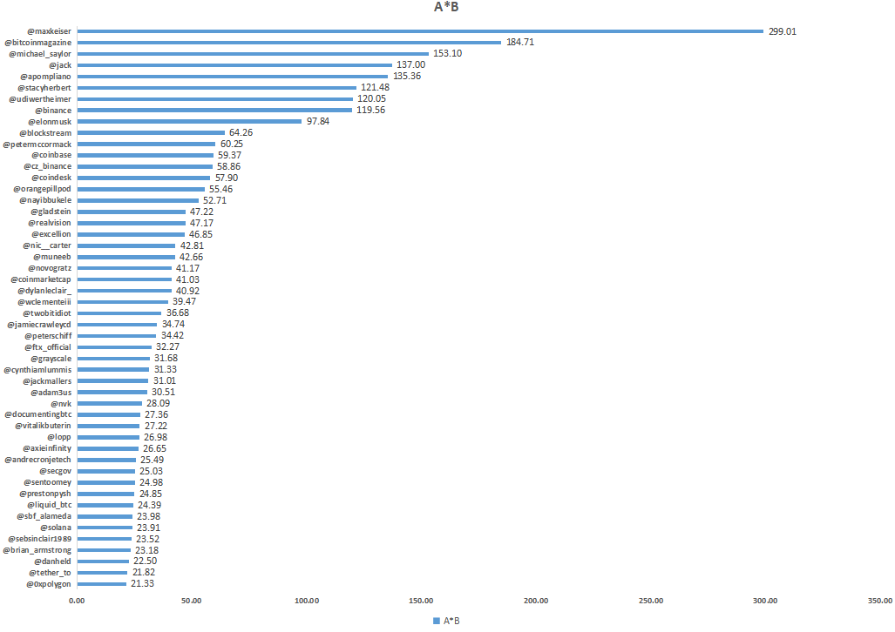
Results: Ranking Based on Product of Mentions and Liquid Rank Score

Slide 11
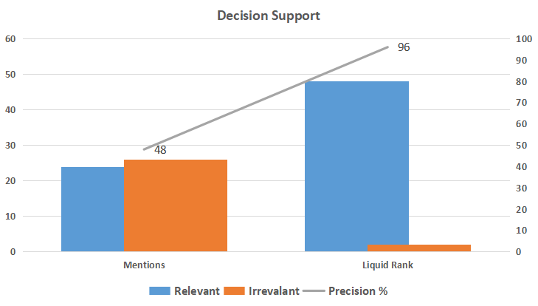
Results Qualitative Analysis: Decision Support

Slide 12
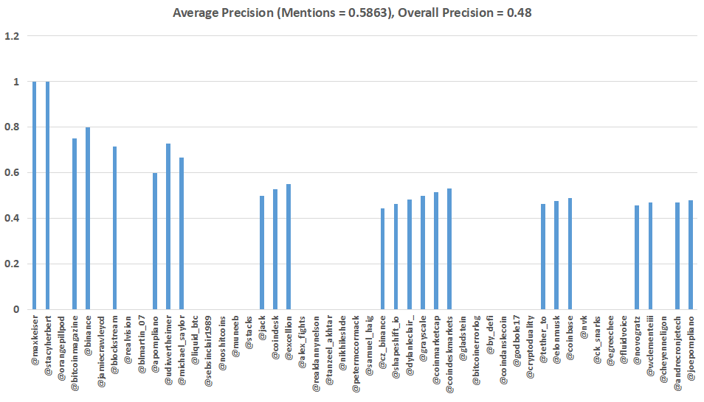
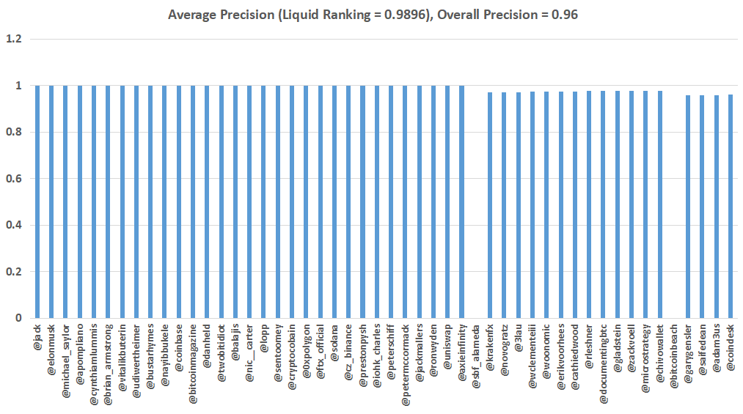
Results Qualitative Analysis: Average Precision

Slide 13
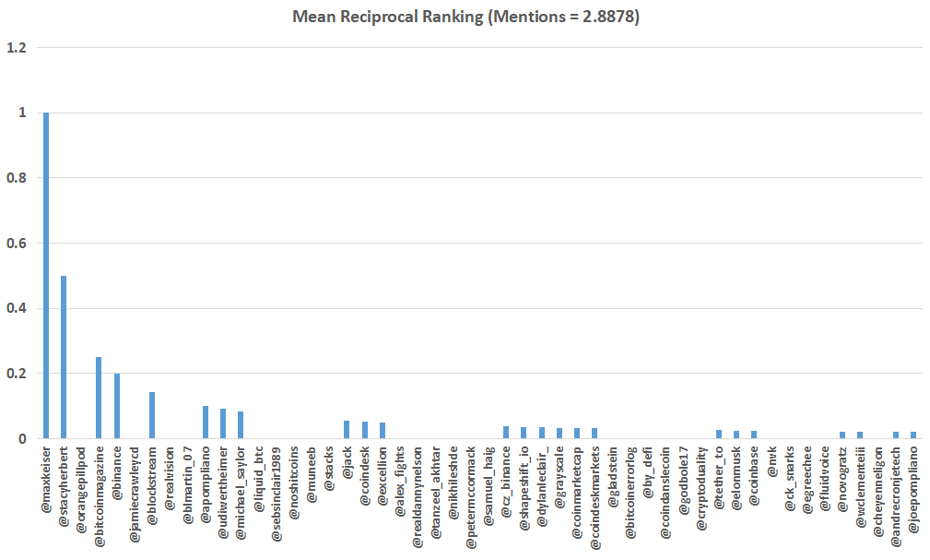
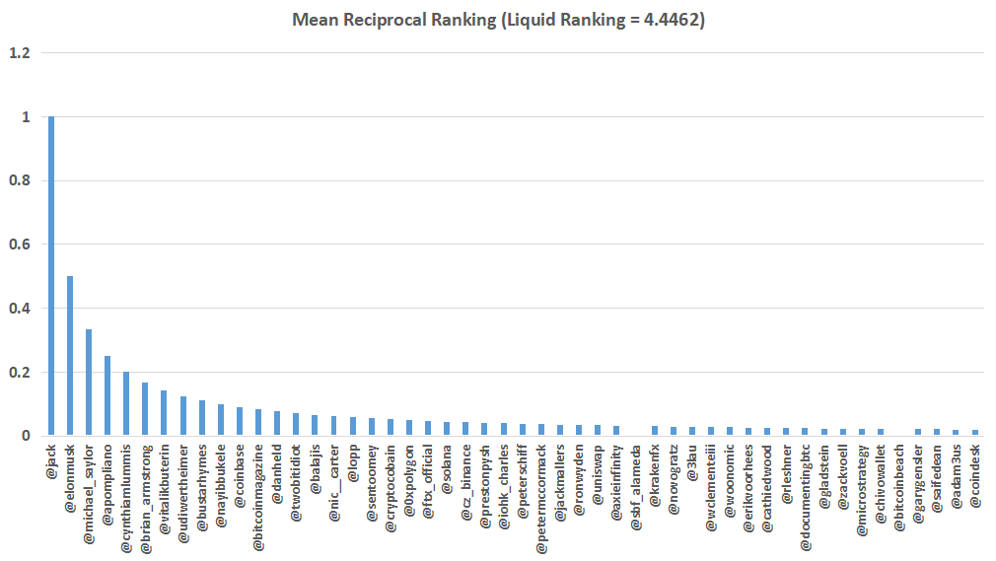
Results Qualitative Analysis: Mean Reciprocal Ranking

Slide 14
Future Scope of Thesis
Liquid Ranking can directly be implemented in the account of social media channel or an online store where Cold Start would be handled by the reputation of our friends and people whom we already follow.
Later this reputation would ripple to more recommendations, starting from our social circle.
Liquid Ranking on multiple attributes can make not only personalised recommendation much better, but also will help new content provider or say here in the case less influential channels also to be recommended (who are producing good work and talked about in our social circle, not viral but surely liked and effective content)
One thing has to be considered that Liquid Ranking, considers the time period of the usage or search, which makes recommendations dynamic and fresh everytime.

Slide 15
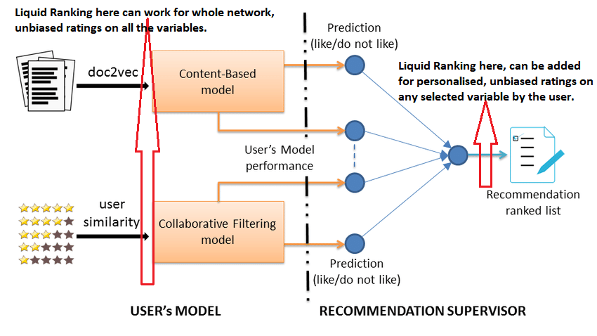
Future Scope of Thesis

Slide 16
Reviewer’s Advice
To improve the quality of work by adding more metrices, else it is comparative to PageRank, HITS methods, etc.
The present dissertation is an application of elaborative and powerfull liquid rank reputation system. Its true the best results can be seen with more metrices, but this is among the primary stages of using reputation system for recommendation models. I have tried to rank the dataset with followers on Twitter also, but it would skew the results towards the large channels or the most influential people on Twitter.
PageRank have limitation of considering the benchmark of authenticated pages to have more value than any other pages on web. Thus, if linked by these High Value pages gives higher index to the page tagged. Reputation system is a dynamic and flexible set of algorithm, the value of the most rated node can be hampered or decrease by negative ratings or in our case it may arise when the particular high reputation channel is not active in the discussion, hence its worth will not be considered at all.

Slide 17

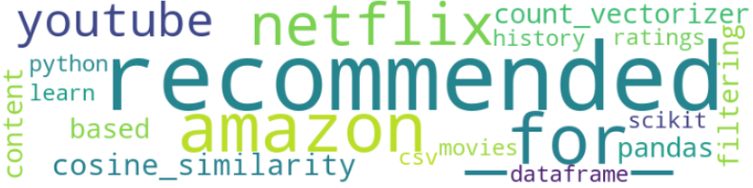

Slide 18
References
A Reputation System for Artificial Societies, https://arxiv.org/ftp/arxiv/papers/1806/1806.07342.pdf
Proof of Reputation as Liquid Democracy for Blockchain https://steemit.com/blockchain/@aigents/proof-of-reputation-as-liquid-democracy-for-blockchain
Liquid Democracy for Distributed AI Systems https://blog.singularitynet.io/reputation-consensus-and-liquid-democracy-based-on-open-ledger-protocol-for-distributed-ai-systems-ffc2e6f387d1

Slide 19
Appendix: Liquid Rank Reputation System for Content Recommendation Dataset
Identifying Opinion Leaders by Mentions and Liquid ranking:
DATASET: Sample dataset from Twitter and Reddit on Cryptonews Feed has been taken for finding opinion leaders (or can be considered as recommendation for new channels on twitter which are having impact on the related topic in that time frame)
Only Twitter Data is selected upon to build the algorithm of Content Recommendation System, dataset contain 37605 tweets and more than 10k channels (twitter accounts).
Opinion Leaders are found on the basis of the “Mentions” by the selected channels which were used to fetch data in that time frame.
Considering direct mentions by the channels as the area of interest to find new recommendation ranking.

Slide 20

Appendix: Liquid Ranking for Content Recommendation
Identifying opinion leaders by liquid ranking:
Initial Phase Algorithm used to build the Architecture for Content Recommendation:
Architecture: Code has been built from scratch currently, will need updation according to new features in future.
Initially reputation score was given as 1 to everyone.
Opinion Leaders are found on the basis of the “Mentions” by the selected channels, these mentions work as Weights (multiplier) to build new reputation score.
Every loop of reputation scoring, follows normalisation of data (within positive range)
The end results are as follows.
$$Rj =\sum{(Ri ∗ Vijt)}$$

Slide 21
Appendix: Qualitative Analysis
Channels only rated 2(max) are considered to be relevant.
Ratings are given considering, the number of tweets, number of tweets everyday, retweets, likes and comments.
There are almost 8500+ channels, only top 50 of each mention based and liquid ranking were considered.
Liquid ranking feature can be added to a recommendation model as a layer, for personalise and dynamic recommendation.
How Personalised: e.g. considering Twitter data, personal connections’ following can be used as base of liquid ranking to get recommendations.
How dynamic: Each feature used as base of liquid ranking can be seen as a timestamped transaction, hence the recommendation can be dynamic.

Slide 22
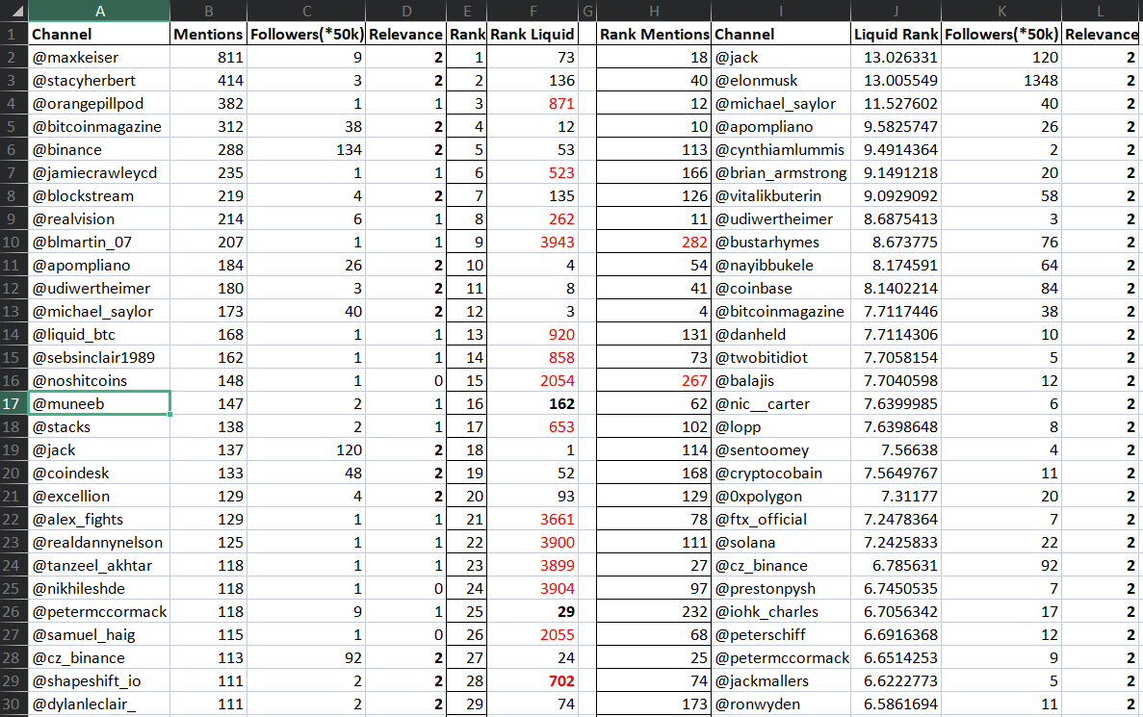
Appendix: Results

Slide 23
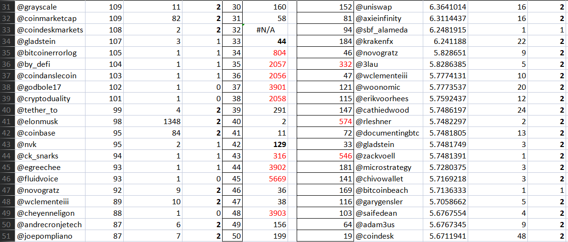
Appendix: Results

Slide 24
Appendix: End Results
LIQUID RANKING CODE: https://github.com/xenvik/Recommendation-Model/blob/main/Liquid_Ranking.py
RANK COMPARISON (BY MENTIONS AND LIQUID RANKING):

